Slide 1
MASK DETECTION SYSTEM
presented by
Shubham Ramjanak Maurya

Slide 2
INTRODUCTION
In this project we have developed the web app which will predict the various diseases.
The user have to give input of the basic health data on the UI
There are 3 disease which project can predict
1) Diabetes 2) Heart Disease 3) Parkinsons’s

Slide 3
PROBLEM DEFINATION
The problem at hand is to develop a predictive model that can accurately predict the likelihood of multiple diseases in individuals based on their relevant health data and medical history.
Data Collection and Integration
Feature Selection and Engineering
Algorithm Deployment
Model Training and Evaluation
Interpretability and Explain ability
Integration into Clinical Workflow

Slide 4
PROJECT OBJECTIVE
The objective of the MULTIPLE DISEASE PREDICTION SYSTEM project is to develop a predictive model that can predict the disease by using medical history input.
Early Detection and Prevention
Comprehensive Disease Assessment
Improved Clinical Decision Making
Enhanced Patient Care and Engagement
Efficient Resource Allocation
Continual Improvement and Adaptability

Slide 5
Purpose
The purpose of a MULTIPLE DISEASE PREDICTION SYSTEM project using supervised data.
To develop a predictive model that can accurately forecast the occurrence or probability of multiple diseases or health conditions based on a given set of input variables or features.
The project aims to leverage historical data and patterns to create a reliable tool for early detection, prevention, and management of various diseases..

Slide 6
Scope
The are various aspects related to data collection, preprocessing, model development, and evaluation
Data Collection
Data Preprocessing
Feature Selection/Engineering
Model Development
Model Evaluation
Model Deployment and Integration
Ethical and Legal Considerations

Slide 7
Applicability
Applicability across various domains and can be beneficial in several contexts.
Clinical Decision Support
Disease Prevention and Early Intervention
Public Health Planning
Personalized Medicine and Precision Healthcare
Clinical Trials and Research
Health Insurance and Actuarial Analysis

Slide 8
SOFTWARE REQUIREMENTS
Software Requirements:
Operating System – Windows
Web-Technology - Streamlit frame work in Spyder
Back-End- Python in Google Colab
Environment – Conda
Libraries - Numpy, Pandas, Matplotlib, Sci-kit learn, Pickle, Streamlit
Database - Dataset

Slide 9
HARDWARE REQUIREMENTS
Hardware Requirements
Pentium-IV (Processor)
RAM - 256 MB RAM
512 KB Cache Memory
Hard Disk 10 GB
Microsoft Compatible 101 or More Key Board
Bandwidth with 100kbps or above

Slide 10
Tools and technology used
Hardware Requirement:
Processor - Intel core i3
ROM - 52xCD ROM
RAM - 4GB
Others - Mouse, Keyboard, Router etc.
Operating System - Windows XP and later
CPU - Pentium 3, 500Mhz
Hard Disk - 500MB free space
Network Speed - 128 Kbits/sec
Graphics Card - DirectX9 and 3D capable with 64MB of VRAM
Screen - 1024x768, "16-bit High Color" - DirectX 9 (to run in Direct X mode)

Slide 11
Use Case Diagram
+------------------------+
| Disease Prediction |
+------------------------+
|
|
V
+---------------------------------+
| User Interface |
+---------------------------------+
|
|
+-----------------------------+
| User Input |
+-----------------------------+
|
|
+-----------------------------+
| Process User Input |
+-----------------------------+
|
|
n |
+---------------------------+
|
|
+-----------------------------+
| Display Prediction |
+-------------------------------+
| Disease Prediction |
+-------------------------------+
|
|
+-------------------------+
| Diabetes Prediction |
+-------------------------+
|
|
+-------------------------+
| Heart Disease Prediction |
+-------------------------+
|
|
+---------------------------+
| Parkinson's Prediction

Slide 12
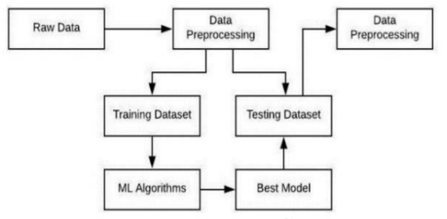
Block Diagram

Slide 13
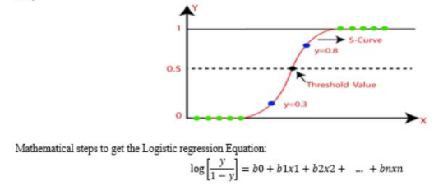
Mathematical Models
Logistic Regression

Slide 14
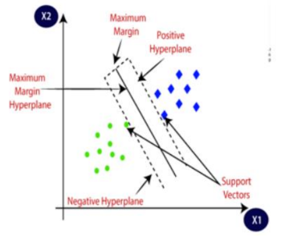
Mathematical Models
SVM(Support Vector Machine)

Slide 15
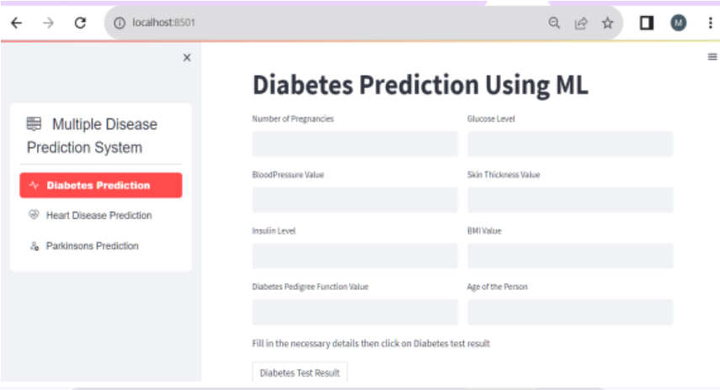
Testing Approach Procedural Design

Slide 16
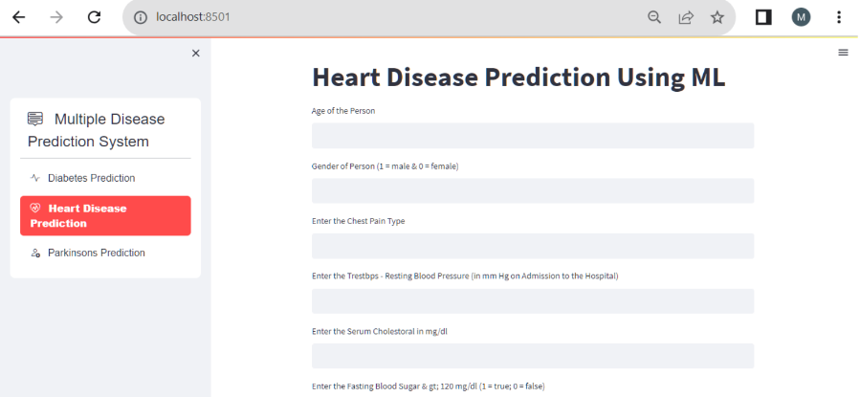

Slide 17
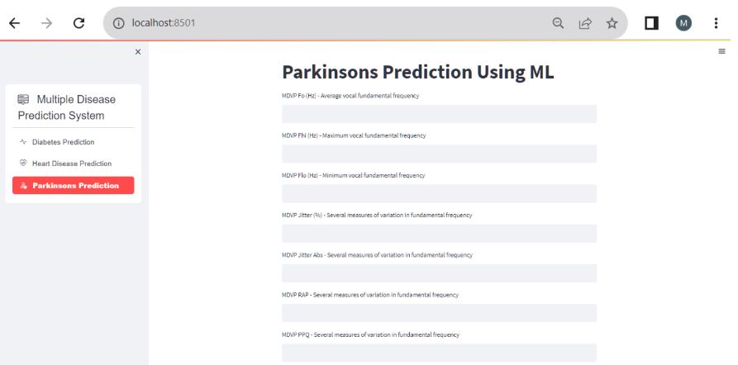

Slide 18
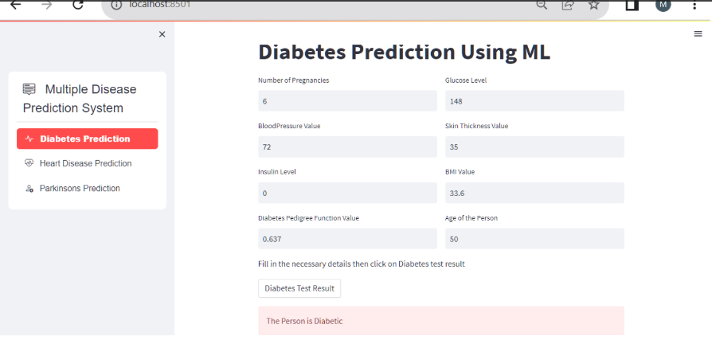
Testing Approach Procedural Design

Slide 19
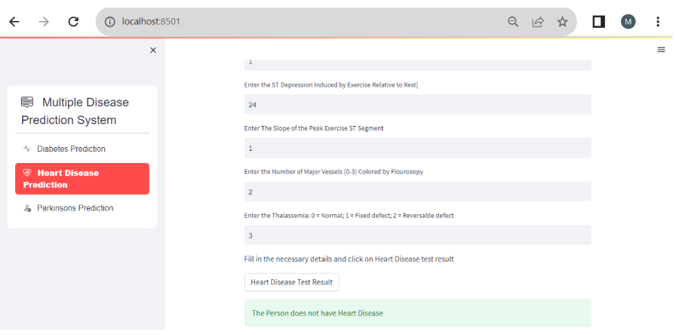
Testing Approach Procedural Design

Slide 20
Project Conclusion
We successfully build a system that predict more than one disease with high accuracy.
It is easy to use as well.
Our project identifies heart disease with an accuracy of 88%.
Our project predicts diabetes disease with an accuracy of 78%.
Our project predicts Parkinsin’s disease with an accuracy of 89%.

Slide 21
Future Enhancement
It will be very useful to healthcare industries like hospitals to identify diseases at early stage.
In the future we can add more diseases in the existing system.
We can try to improve the accuracy of prediction in order to decrease the mortality rate.
Try to make the system more user-friendly.

Slide 22
Thank you

